Slide 1
LEGO ELEVATOR
Ambrus Bence tibor, d1o4nv

Slide 2
Concept
lego elevator
The idea was to build an elevator using:
LEGO
Arduino UNO
DC or stepper motor
motor driver circuit
some electrical components

Slide 3
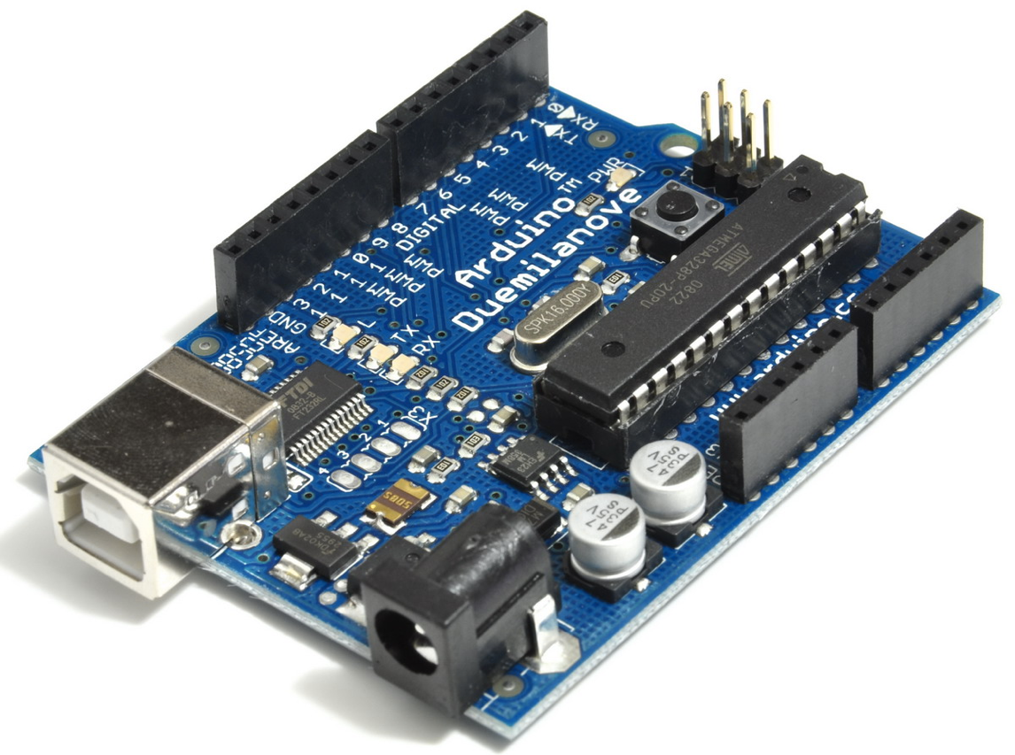
ARDUINO UNO R3 / DUEMILANOVE
lego elevator
I have both of them, they are almost fully identical.
Decided to use Duemilanove because UNO wasn’t recognizedby my girlfriend’s Macbook.
This is a cheap and very widely used and supported microcontroller
It has digital and analog I/O ports that are easy to configure.
The soul of it is a 16.000 MHz crystal.

Slide 4
Things I’ve tried
lego elevator

Slide 5
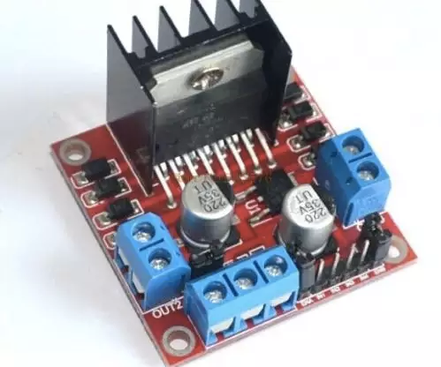
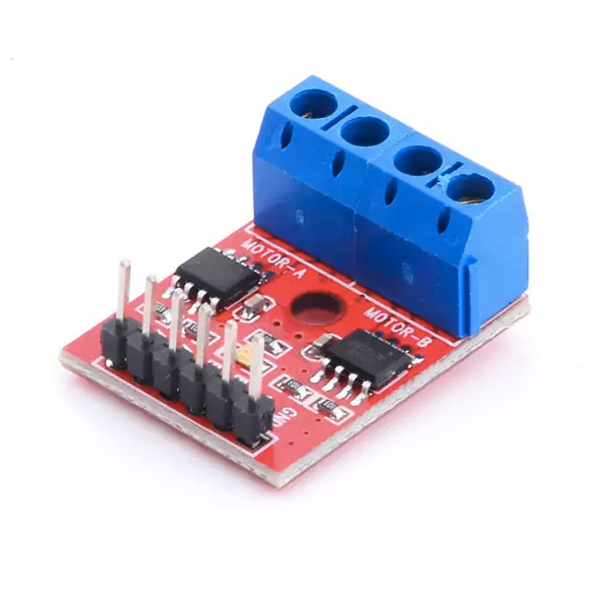
driver
lego elevator
Originally used an L298N:
has PWM
Replaced with L9110:
no PWM
Arduino has PWM output
smaller

Slide 6
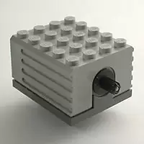
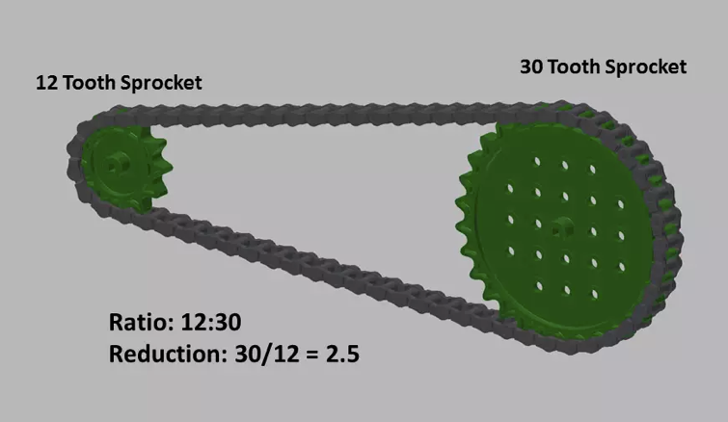
Electric Technic Motor 9V
lego elevator
ungeared
high speed
low torque
strong enough to lift cabin
gear reduction was needed

Slide 7
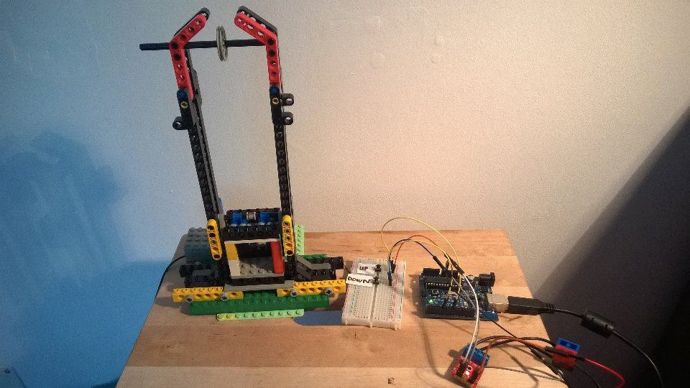
overall picture
lego elevator

Slide 8
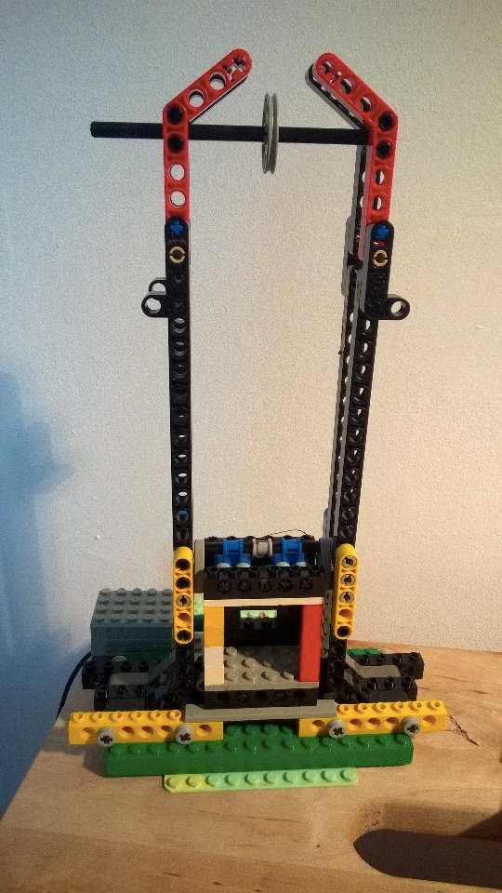
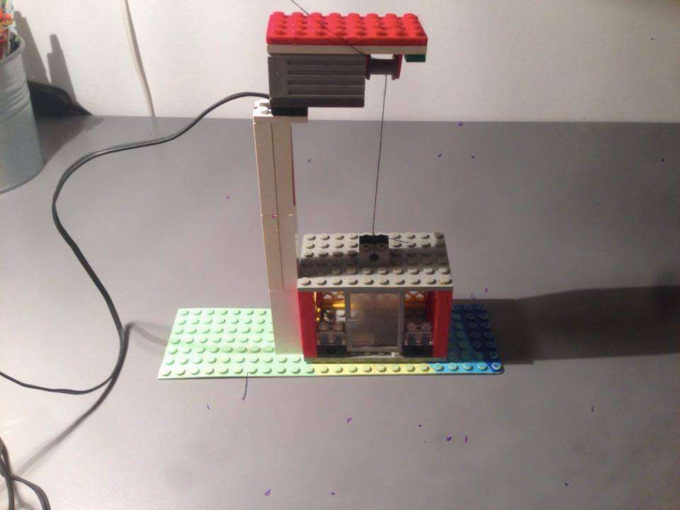
before - after
lego elevator

Slide 9
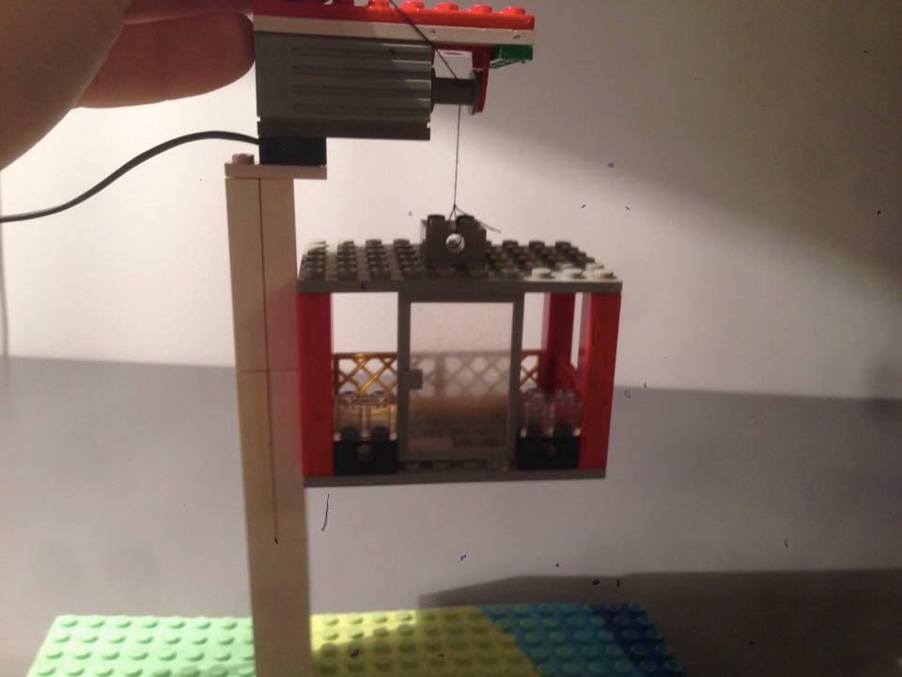
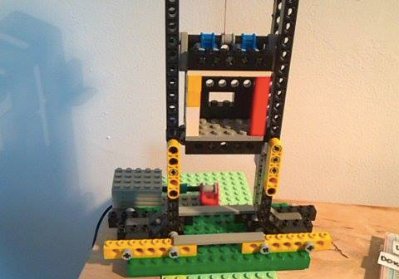
before - after
lego elevator

Slide 10
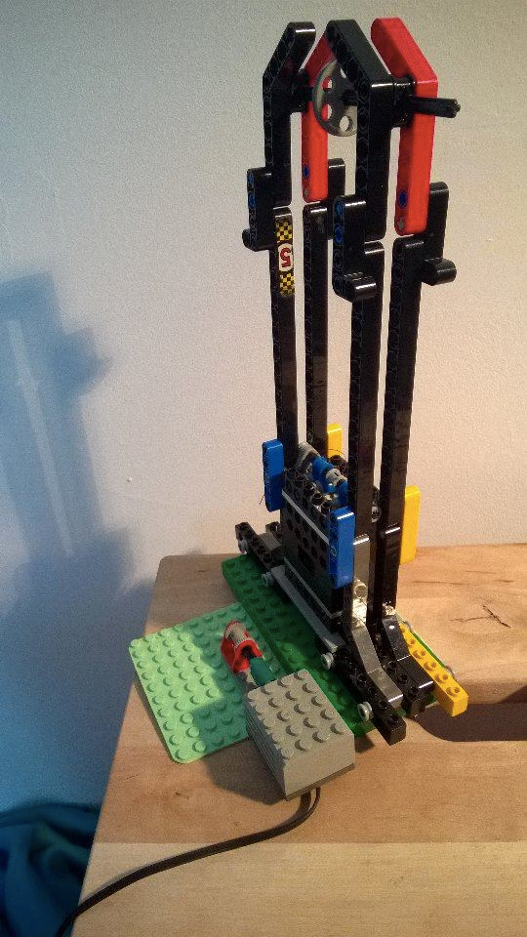
elevator
lego elevator
3-storey-tall
made of Technics elements
used thread but it always tears
replaced with fishing line (damil)
no horizontal swinging

Slide 11
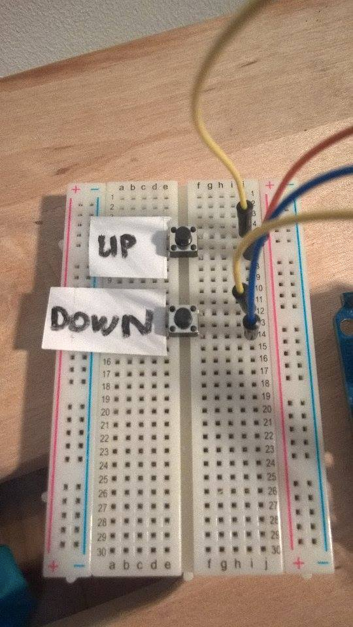
control unit
lego elevator
early stage
can move up and down
manual working
cannot be called from levels

Slide 12
Final stage
Lego elevator

Slide 13
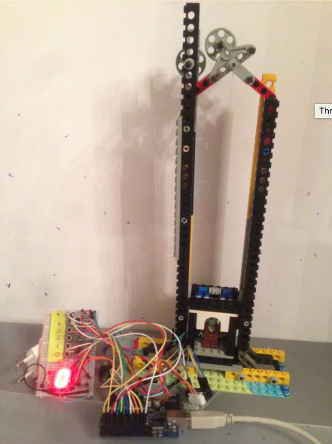
Overall picture
Lego elevator
The elevator functions as desired.
It has 4 levels.
All 3 requirements have been fulfilled.
Bit slow but punctual.

Slide 14
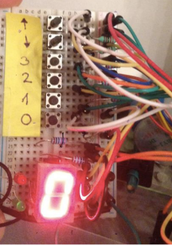
The control panel
Lego elevator
Consists of:
4 level calling buttons
Up and down buttons
7 segment display (with shift register below)
Red LED indicating going up
Green LED indicating going down

Slide 15
7 segment display
Lego elevator
This is a common cathode display with red LEDs built in
Shift register is a 74HC595N by Texas Instruments
It took a while to understand the working and controlling principles of the display but it was interesting to learn it.
Some soldering was needed to save some space on the board

Slide 16
Stepper motor
Lego elevator
28BYJ-48 stepper motor is used
Works with 5V
Number of phases: 4
Torque: 4.3mN.m
Resolution: 5.625°
It has 4096 steps resolution
The motor has 360/5.625 = 64 steps/rev, but the output shaft has 64 steps/rev * 32 gear ratio = 2048 steps/rev, or 0.17°/step
I use full stepping mode, it gives more torque

Slide 17
Driver circuit
Lego elevator
ULN2003 is used
It is quite trivial how to connect to the motor and to the microcontroller as well
4 LEDs show which coils are active at the moment (in my case it’s way too fast)

Slide 18
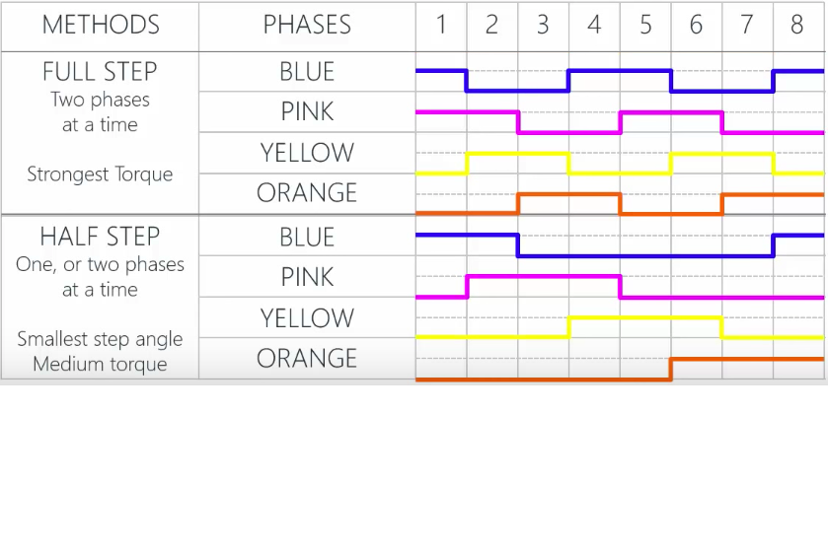
Difference between half and full stepping
Lego elevator

Slide 19
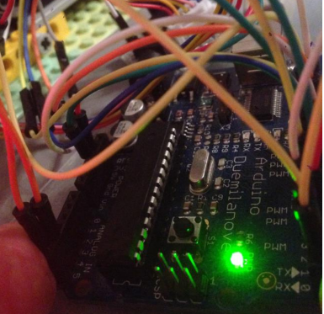
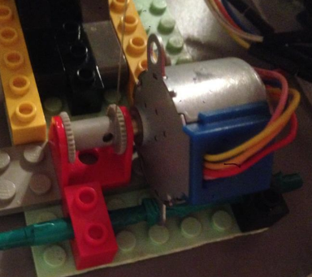
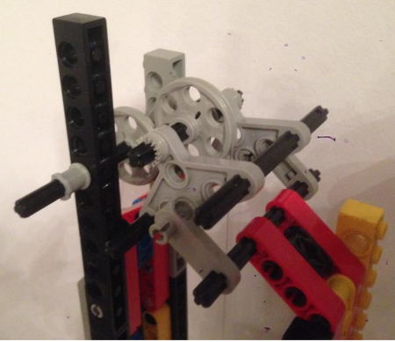
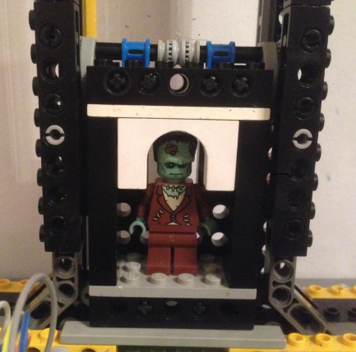
Pictures
Lego elevator

Slide 20
For next semester
Lego elevator
Multiple level calls handling
UP/DOWN calling buttons on each levels
Emergency stop
Use sensors to identify actual level
Connect to a server to send usage data
Remote control
Servo controlled doors

Slide 21
End of presentation
Lego elevator
Thank you very much for
your attention!

